Slide 1

Team Presentation Group 2

Slide 2
Team Members
Pratish Joshi: 1 -4
Bibek Shah: 5
Apil Parajuli: 6 - 9
Bibek Maharjan: 10 - 13
Abit Mahato: 14-23

Slide 3
Project Charter
‘goCart’ is an e-commerce website that assures the availability of different local traders along with their products in a single platform. People nowadays find it difficult to manage their time, so ‘goCart’ can assist them in shopping for their necessities during their busy work schedule. With just a few multiple clicks, they will be able to shop during their busy work schedule from their local and trusted sellers with a fast, safe, and convenient method.

Slide 4
Scopes of Project
To create an e-commerce website that includes several local stores of Cleckhuddersfax having distinct product lines. By exposing our website to audiences of different age groups, our website will gradually increase trader’s profit by having a huge amount of sales with a reduced amount of effort, saving time.
User-Friendly Website for Customer’s and Trader’s
Traders can manage their products and information on their shops using their respective trader’s account.
Traders will be provided with daily, weekly, monthly reports via Dashboard on different categories.
Analysis and Evaluation of the Report and Record.

Slide 5
Belbin Analysis
Name | Primary Role | Secondary Role | Least likely Role
Apil Parajuli | Shaper | Implementer | Monitor Evaluator
Bibek Maharjan | Resource Investigator | Plant | Complete Finisher
Pratish Joshi | Co-ordinator | Specialist | Completer Finisher
Abit Mahato | Monitor Evaluator | Completer Finisher), | Specialist
Bibek Shah | Team Worker | Plant | Co-ordinator

Slide 6
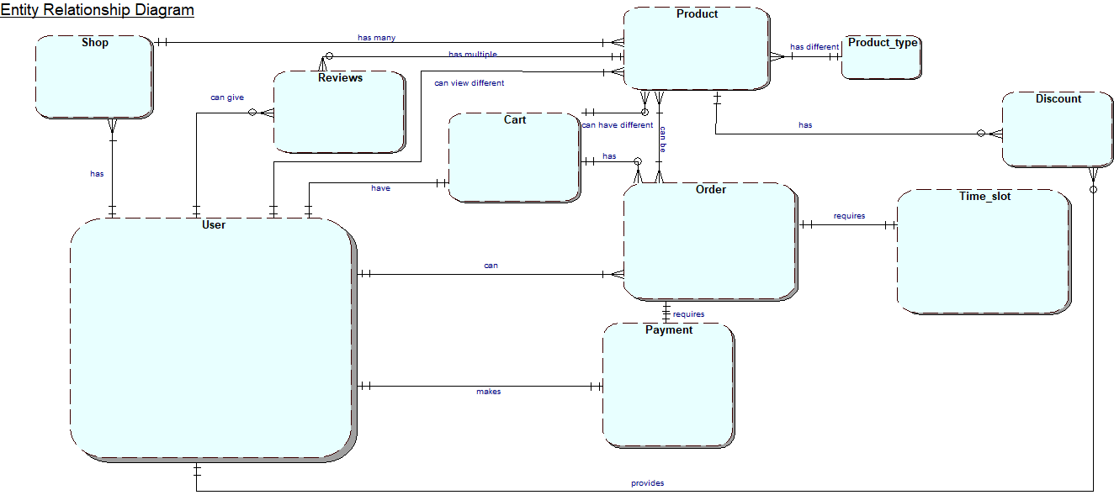
Entity Relationship Diagram

Slide 7
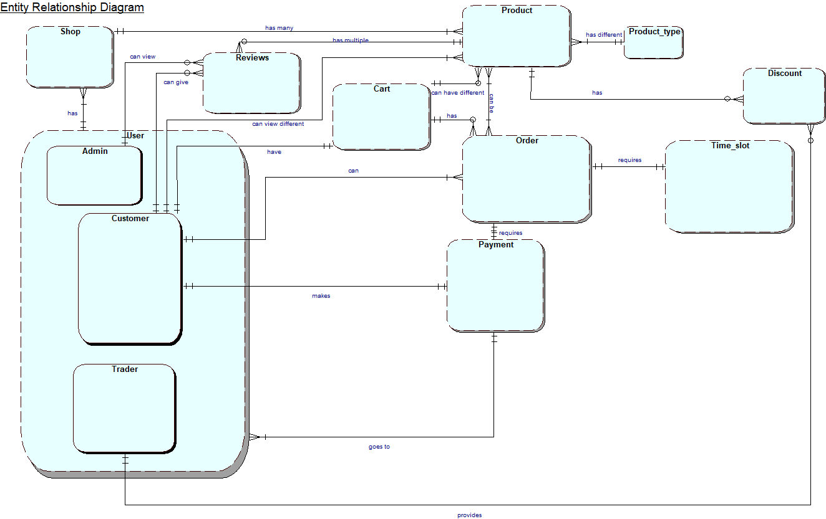
EERD

Slide 8
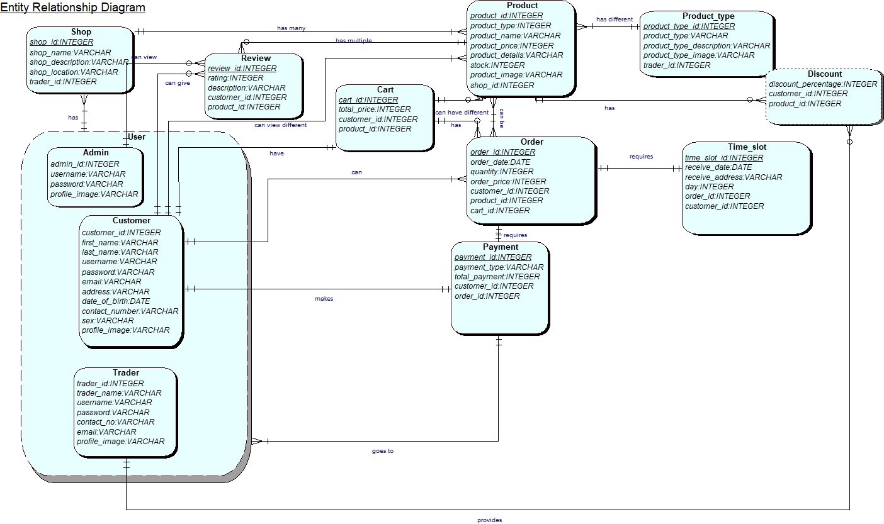
Composite ERD

Slide 9
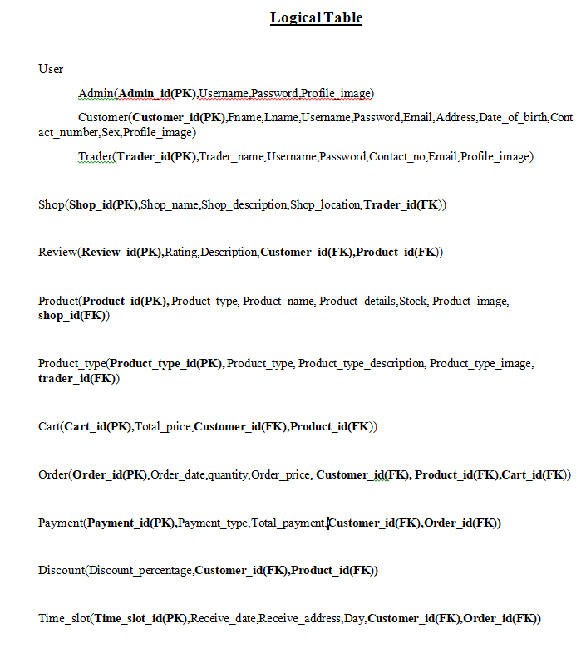
Logical Table

Slide 10
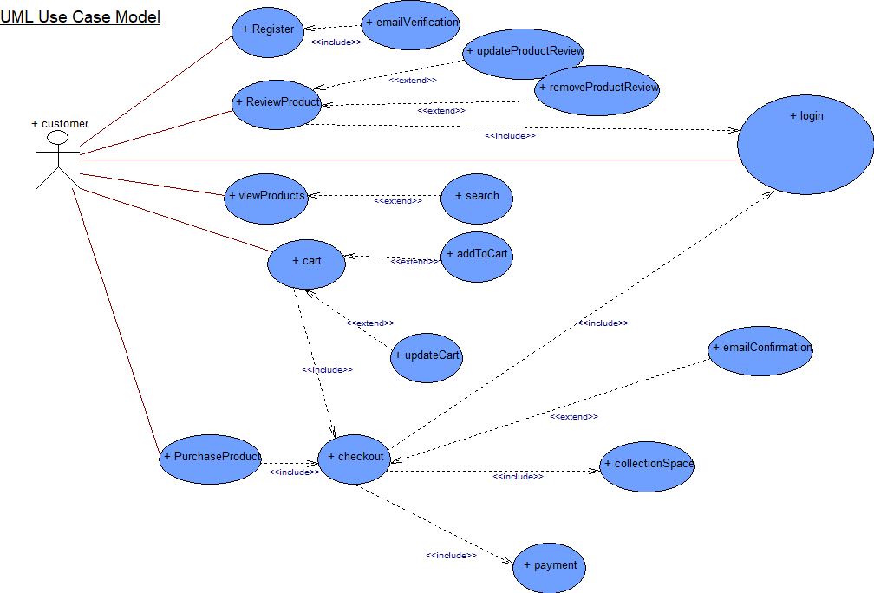
Customer Use Case

Slide 11
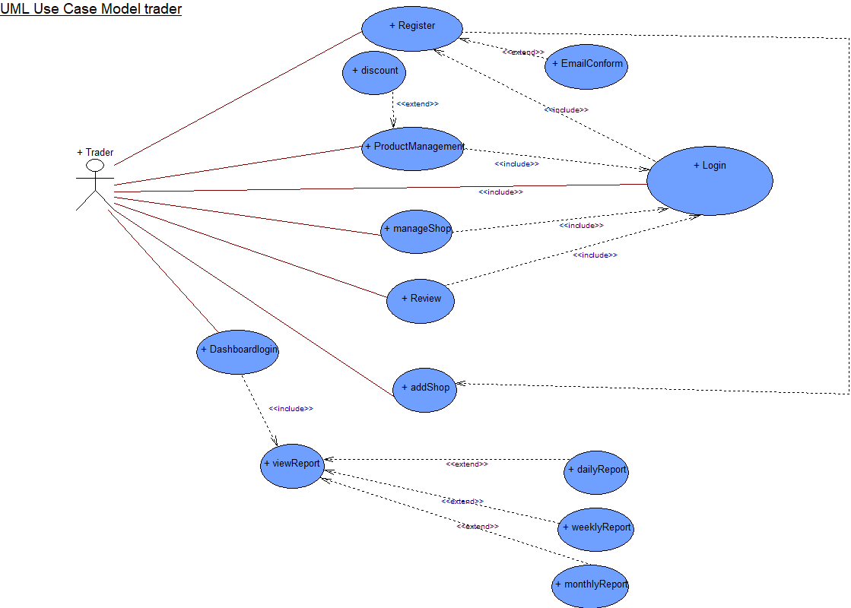
Trader Use Case

Slide 12
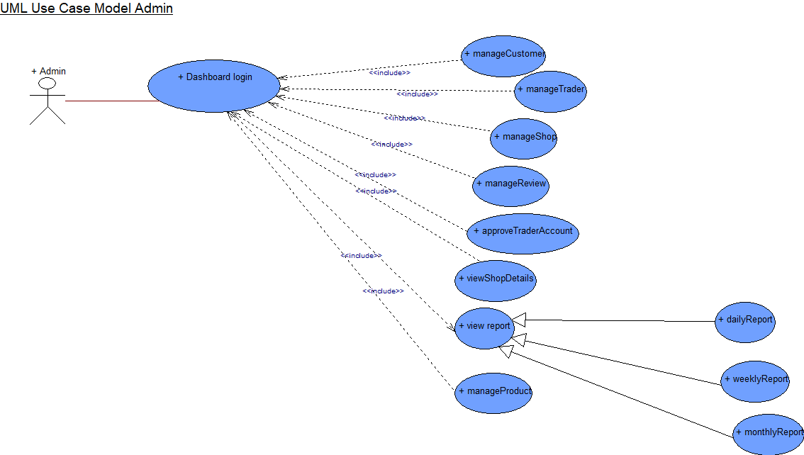
Admin Use Case

Slide 13
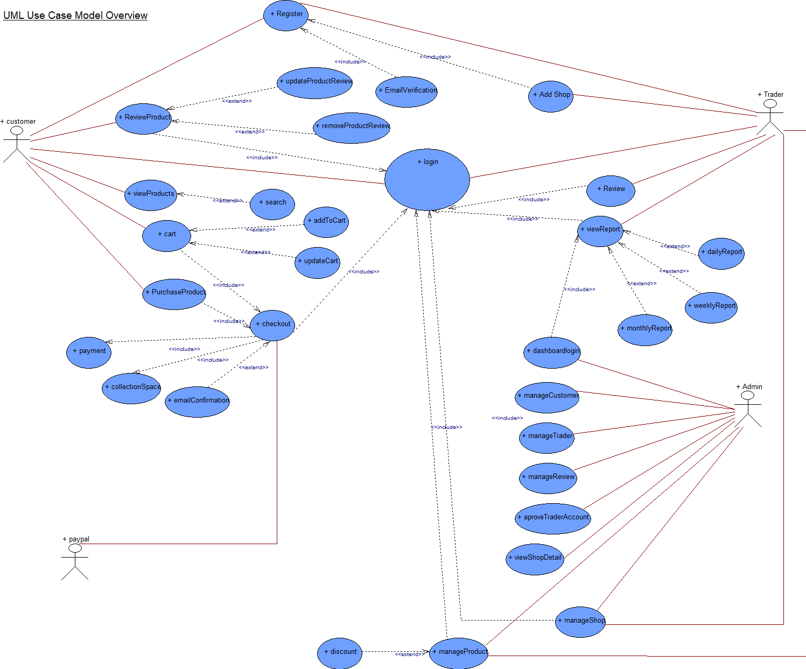
Overview Use Case

Slide 14
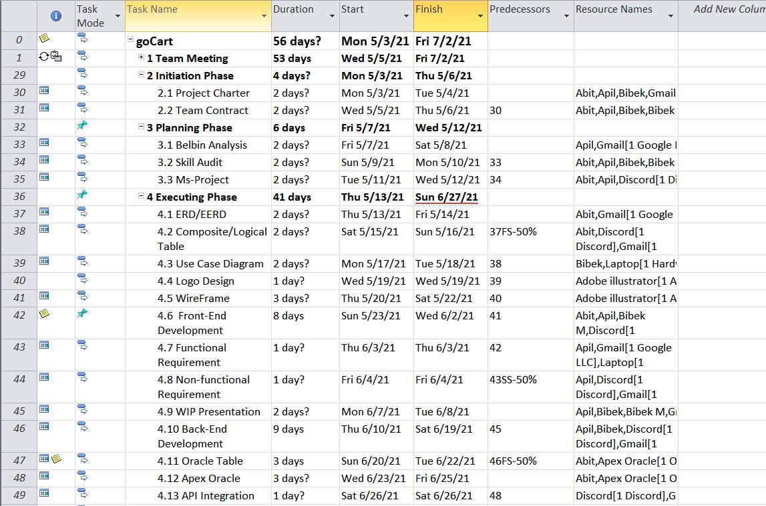
MS Project

Slide 15
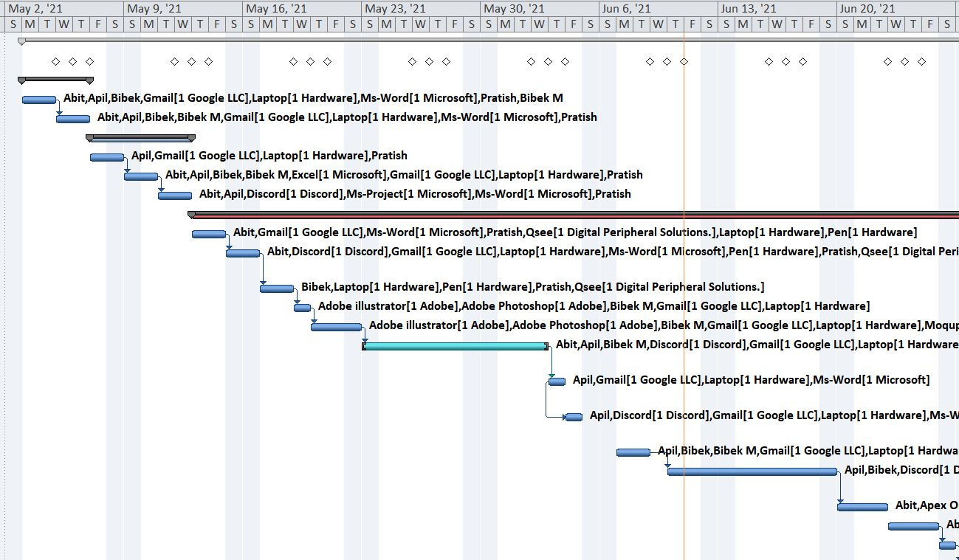
Gnatt Chart

Slide 16
Task Sheet

Slide 17
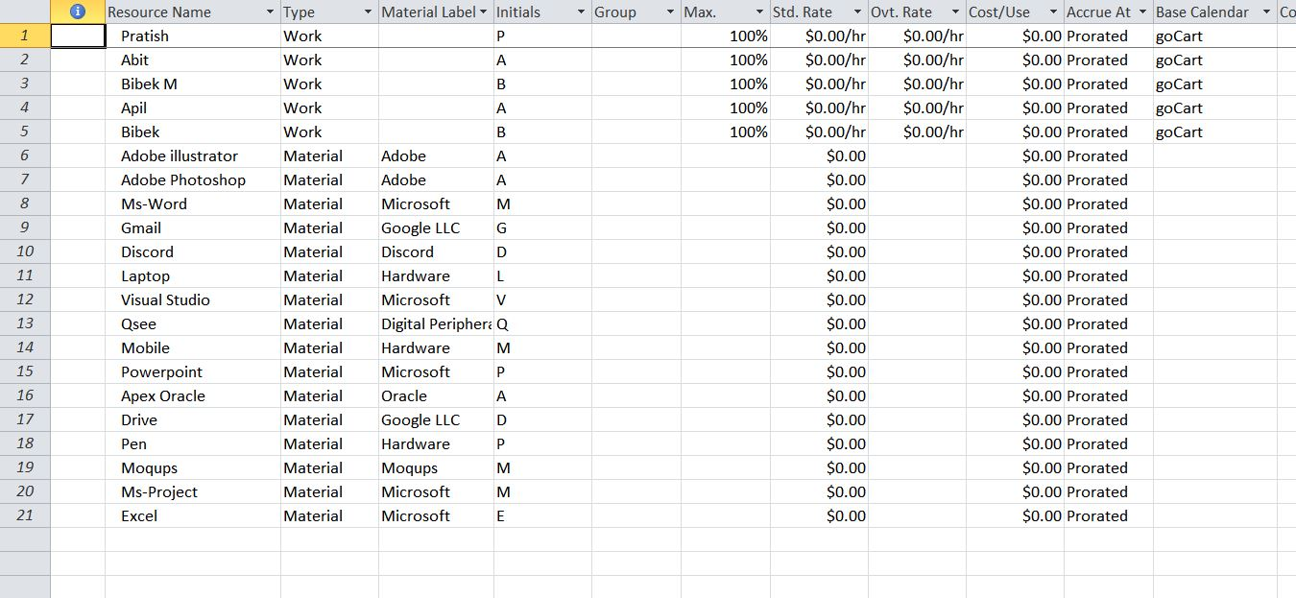
Resource Sheet

Slide 18
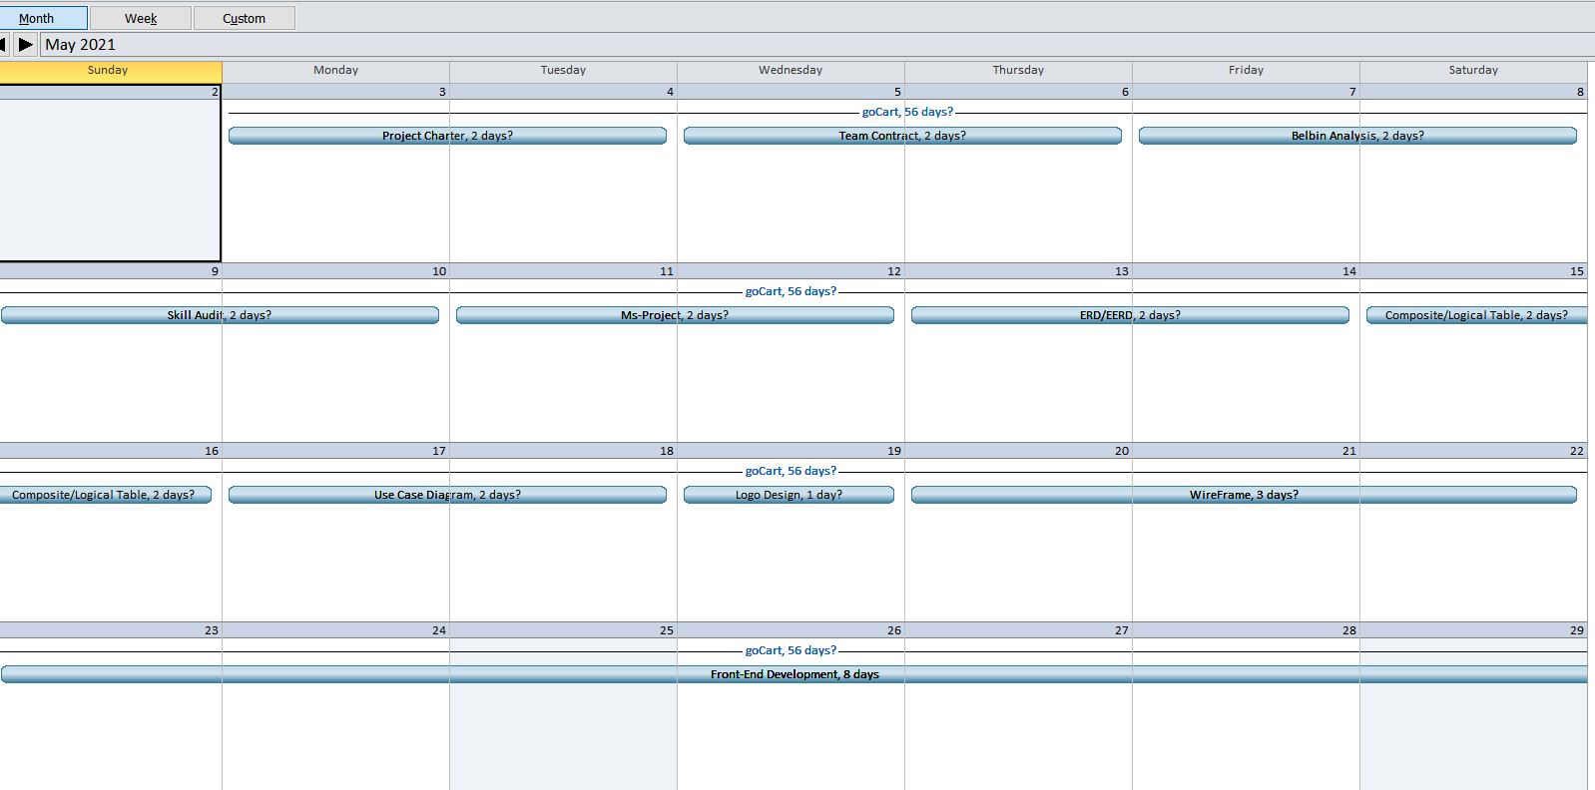
Calendar

Slide 19
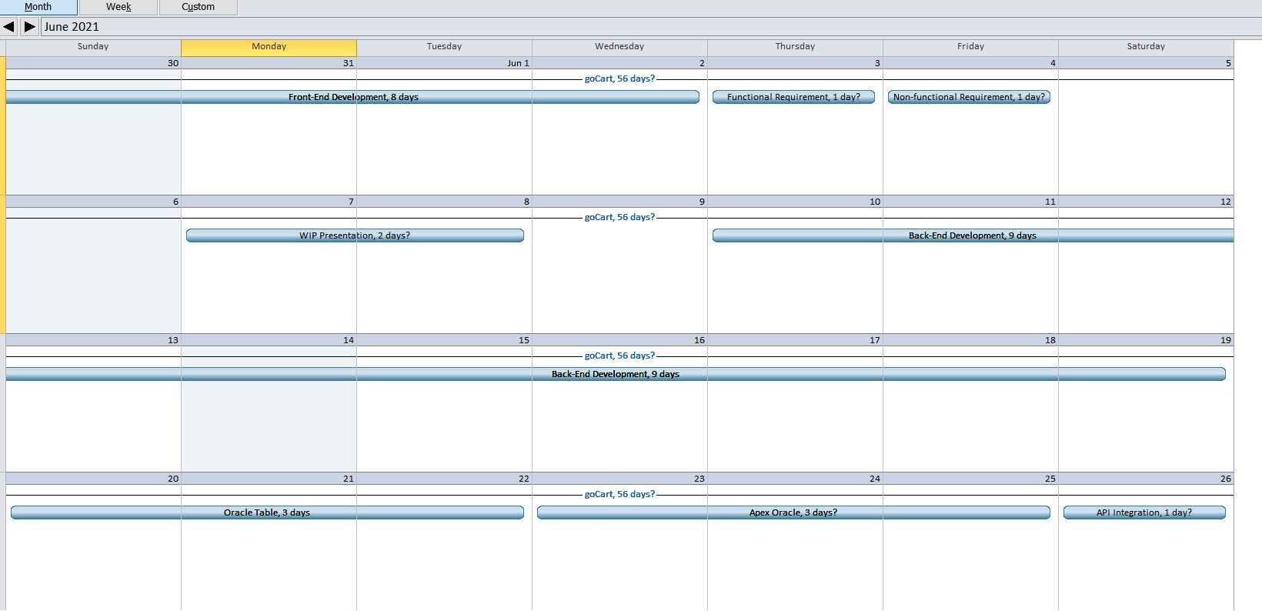
Calendar II

Slide 20
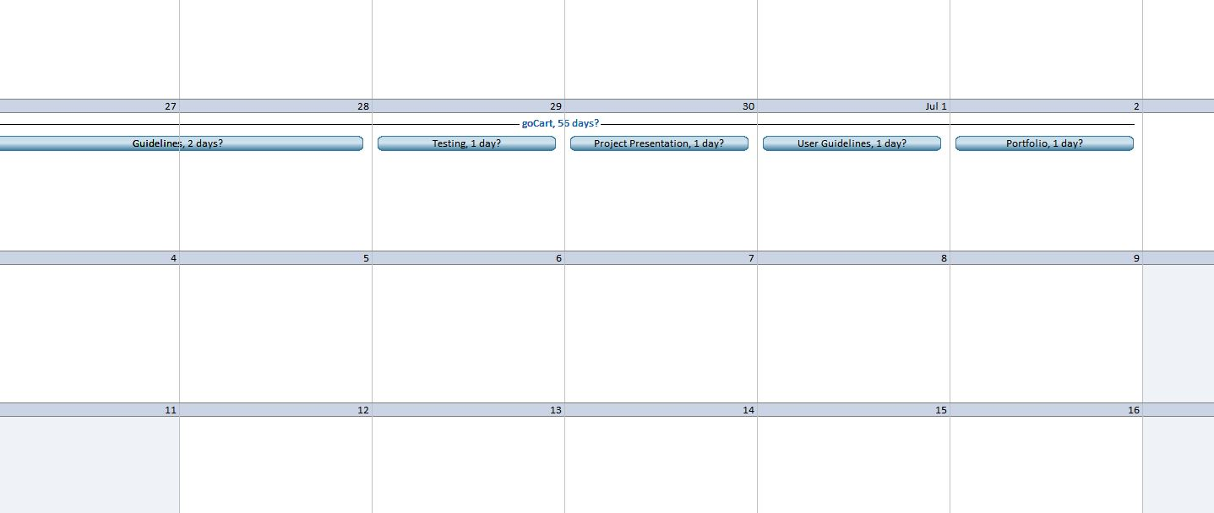
Calendar III

Slide 21
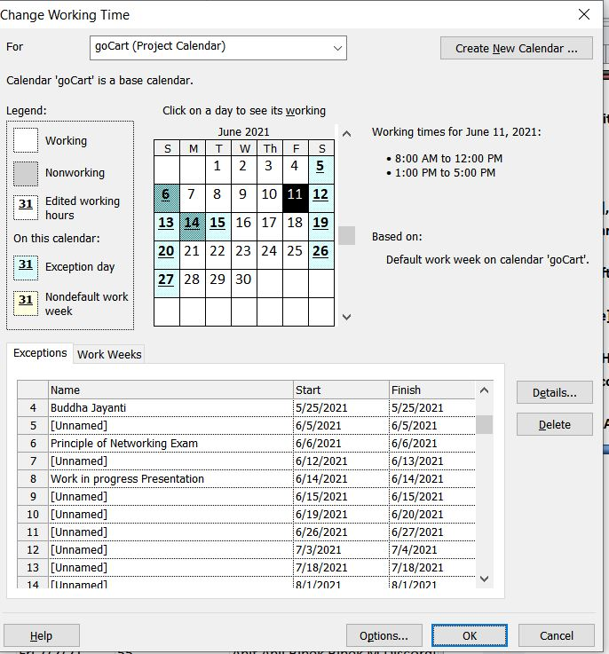
Change Working Time

Slide 22
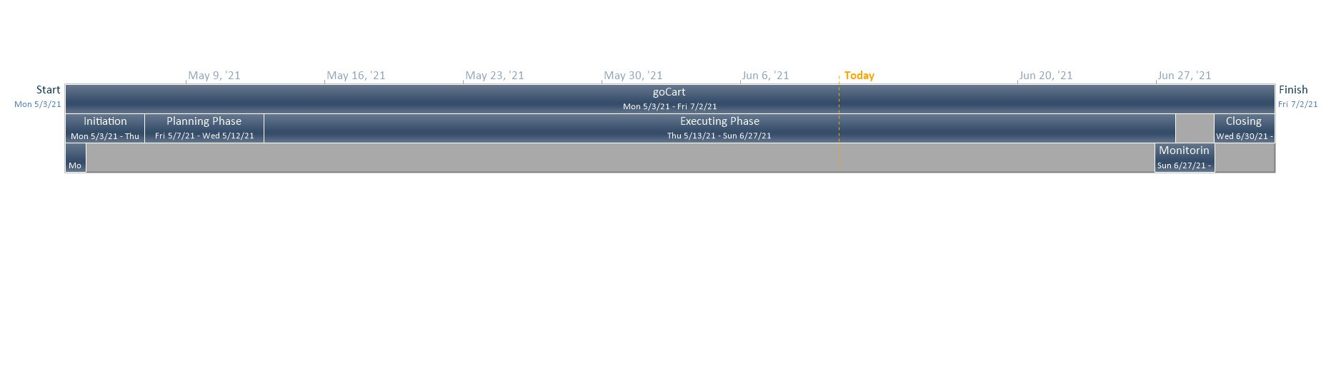
Timeline

Slide 23
Now, Moving on to the Website Demonstration

